Slide 1

GoodSports Goods
Play with Passion

Slide 2

Team Members
Abhitej (Scrum Master)
Hetal (Product Owner)
Chandu
Aabha
Chris
Pavan Kalyan
Pavan
Manasa

Slide 3

Purpose

Slide 4
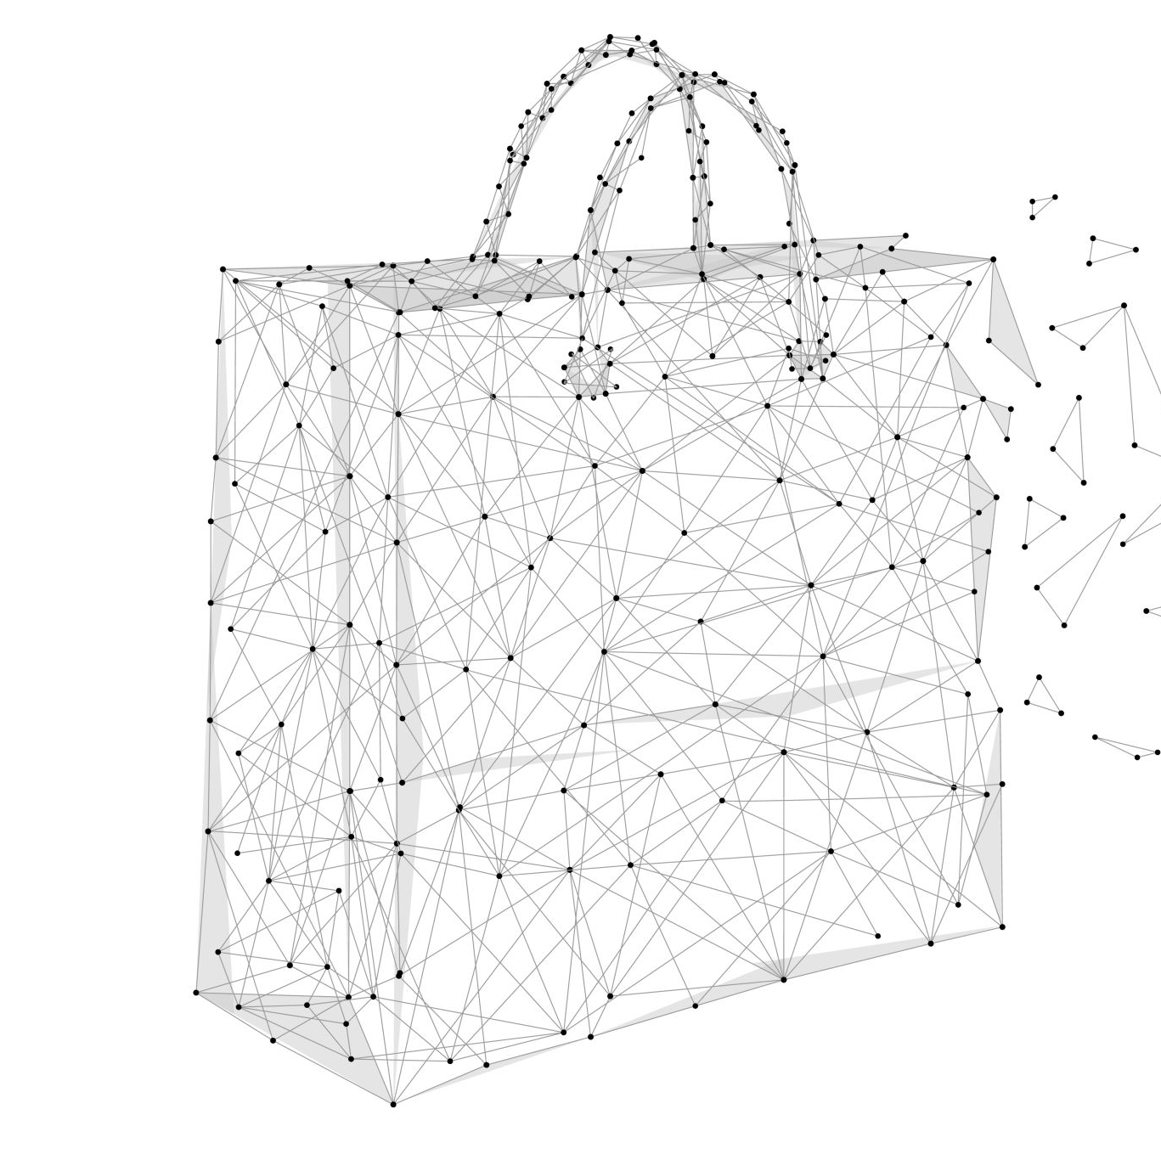
The product we are developing is an E-commerce website intended to enable customers with easy and convenient access to sports goods and products. This includes sports equipment, clothing, safety gears and other such sport products that help athletes and sports enthusiasts to view, buy and enjoy quality sport items at a cheap and reasonable price.

Slide 5

This website aims to provide users with a complete way of buying and customizing popular sporting goods, with the system being easy to understand and use for customers and employees.
The purpose of the document here is to outline and define the software requirements specifications and its related details, such as the scope, definitions, and analysis for the GoodSport Goods website.

Slide 6

Document Conventions
The structure of the SRS document utilizes headers and sub headers for sectioning information. Headers and sub headers will provide a short descriptive title while being numbered and bolded. Other words and important information pertinent to the section have also been bolded. Some listed items in sections may also be italicized to better indicate the item versus the description.

Slide 7

Project Scope

Slide 8

The scope of the Good Sport Goods website is to enable customers to find and customize popular sporting goods of their preference. The intent of the website is to be user-friendly and include numerous different functions. The initial release is to include customizable products, product search system, product reviews and FAQs, product returns, order tracking, coupon codes, and an account system.
The scope and functionalities here aim to satisfy the business’s objective of becoming a prominent shop in the sporting goods market. Existing competitors currently have many popular features for online shopping, so our system must include similar features to attract customers here. Stakeholders of this project are interested in the website having improved products, inventory and shipping management, and discounts and rewards, for example. Our system must also provide new and different features that make us unique to other competitors, such as having fully-customizable products.

Slide 9


Slide 10


Product Perspective
The Good Sport Goods is a brand-new piece of software that will make shopping for sporting goods and accessories online and in shops entirely unnecessary. Over the course of numerous updates, the system is planned to facilitate the sale of products from a variety of sports companies via a unified marketplace, saving consumers time and effort.

Slide 11
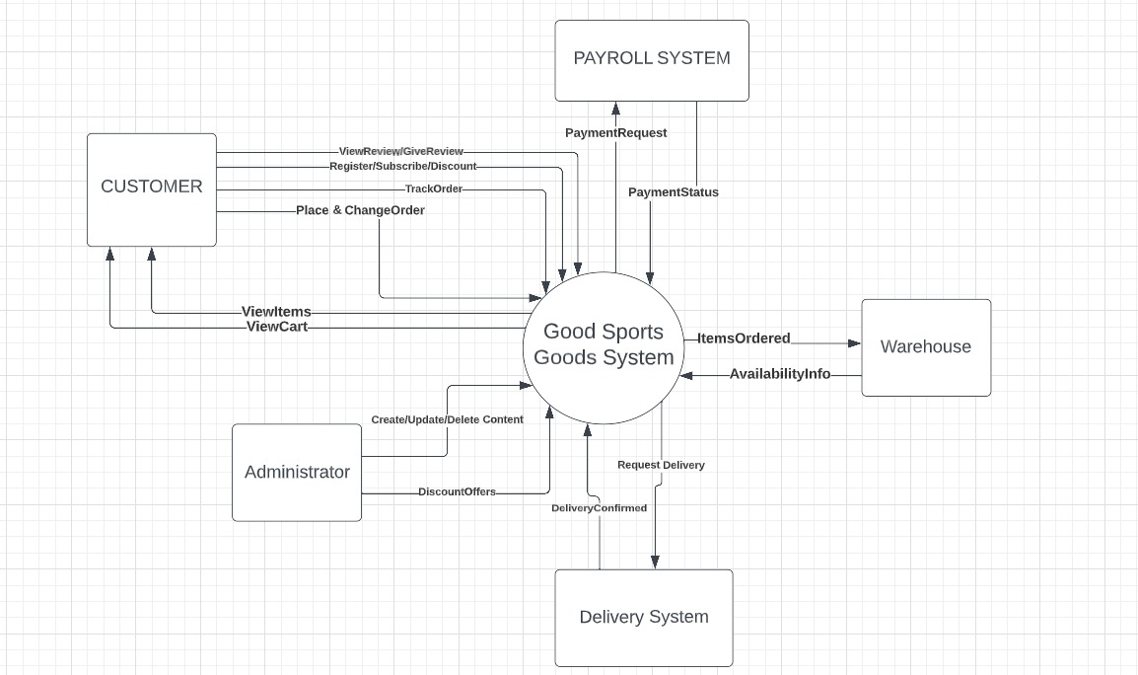

Slide 12

User Classes and Characteristics

Slide 13
User Class | Description
Customers | A Process Impact employee who wishes to place an order for merchandize or equipment via the company's online store is considered a Customer. There are around 1000 prospective Customers, and it is anticipated that 300 of them will utilize the GFG between 8 and 10 times each month on average each. Customers may often place several orders for an item(s) to accommodate group gatherings or visitors. It is anticipated that the company intranet will be used to place orders for forty percent of all purchases, while sixty percent of orders would be made from the comfort of the buyer's home or via the use of mobile applications on their smartphones or tablets.
Administrator | A person who plays a crucial part in the process of generating, updating, and removing material on a website is called an Administrator. Discounts are another responsibility of the Admin when it comes to putting up the site. A website administrator is responsible for managing any upgrades or modifications to the system, as well as any problems that occur.
Payment Agent | The payment agent is primarily responsible for managing transactions. He is accountable for not only presenting the current payment status but also producing a payment history.
Inventory Manager | The Inventory Manager of Good Sport Goods is responsible for checking the availability of the Goods and producing a report on their utilization.
Goods Deliverer | The goods deliverer plays a significant part in delivering the product to the final consumer, and he is also accountable for the distribution of printed materials. Additionally, instruction serves as delivery confirmation.

Slide 14

Operating Environment
OE-1: The GSG shall finely operate with following web browsers:
Firefox Versions v12-26;
Google Chrome Versions v68-107;
Apple Safari Versions 6.0 through 8.0;
Windows Internet Explorer (All Versions);
Opera versions v90,v91 and v92.
OE-2: The GSG must be operated on a server that is running the most current versions of Apache HTTP Server that have been authorized by the corporation.
OE-3: The GSG must be accessible through business intranet, virtual private network (VPN) Internet connection, and mobile devices running Android, iOS, and Windows.

Slide 15

Assumptions and Dependencies

Slide 16

AS-1: The Good Sport Goods e-commerce website is available all over the year. Any updates or changes to the portal will be notified and the portal can be down for a notified amount of period.
DE-1: The functioning of the GSG portal depends on changes being made in the Payroll System to accept payment requests for items ordered with the GSG.
DE-2: As GSG takes inventory orders, the functioning of the GSG is also dependent on the modifications that are made to the GSG Inventory System in order to update the availability of products and equipment.

Slide 17

System Features

Slide 18
Search and View Sports Goods Items
Description
Customers of Good Sports Goods (GSG), whether registered users of the system or not, can search and see the goods items, read product descriptions and reviews, look at photographs and videos linked to the product, view ratings, and search for specific products from the search bar product catalog, trending list, and recommended list. Priority = High.

Slide 19
Search and View Sports Goods Items
Stimulus/Response Sequences
A customer types a specific item into the search box or select from the trending list
The system shows a dropdown menu of associated products from the catalog.
A customer selects an item from the drop-down menu.
The system displays a variety of items for the product you searched for.
The customer can examine a list of all the available things and choose any that appeals to them

Slide 20
Functional Requirements
Product.Search .Icon .ParticularItem .Found | Search Bar The GSG system provides a search bar and search icon Customer enters particular item System returns the list from catalog if item related to searched product is found or shows not found
Product.Trending .TrendingItems .View | Trending List The system displays the most trending items Customer can select and view any of the trending list items
Product.Read .SelectItem .Description .Read | Read description, reviews and ratings Customer selects particular item System provides detail description for that product Customer reads the description, reviews and ratings
Product.Photos .DisplayPhotos .LookPhotos | Look at photos and videos of the product System displays photos or videos for searched product Customer looks at the photos and videos

Slide 21
Buy Good Items
Description
The online sports goods system only allows registered users to choose products, add them to their shopping carts, and then purchase the goods to have them delivered. Priority = High

Slide 22
Buy Good Items
Stimulus/Response Sequences
Customer can place the one or more selected products in the cart
System stores that item in the cart for the customer until customer orders or removes that item from cart or till the availability of the item
Customer whenever wants can go to cart and click on buy products
System will redirect to review page
Customer will check all the details and click next
System navigates to the payment page
Customer will enter the card details and pay for item
System confirms the order and sends an email confirmation to the customer
System stores the order and informs the inventory and delivery system for product delivery

Slide 23
Functional Requirements
Product.Units .ItemNumber .OneItem .MultipleItem | Select one or multiple products The system allows the customer to select one or multiple items Customer can select one item & proceed to buy Customer can select multiple items and add them in cart
Product.Buy .DisplayCart .Buy .Review | Review & Place order System displays all the items in the cart Customer can view the cart and accordingly buy those items System provide the final review for the order
Product.CusDetails .EnterDetails .Details | Provide customer details System request to fill the required details Customer provides the mailing, billing as well as delivery details
Product.Payment .PaymentPage .Payment .Confirm | Product Payment & confirmation System navigates to the payment page Customer pays the purchased amount system send an e-mail confirmation for the purchased items

Slide 24
Modify & Cancel Goods Items
Description
The customer can change the number, color, size, and other aspects of the chosen product. The consumer can cancel an order at any moment before paying for the product if they decide not to purchase the item by removing it from their shopping cart. Priority = High

Slide 25
Modify & Cancel Goods Items
Stimulus/Response Sequences
System will ask for the quantity, size, type, color, or other thing for all the products
Customer can provide the input for all such requirements
System provides preview for the items as per the given requirements
Customer confirms the requirements and proceeds to buy the goods Items
System will redirect to review page
Customer will check all the details and click next
System navigates to the payment page
Customer will enter the card details and pay for item
System confirms the order and sends an email confirmation to the customer

Slide 26
Functional Requirements
Product.Modify .DisplayCart .ModifyItem .Confirm | Modify Item The system displays the added products in the shopping cart Customer modifies the quantity, color etc. System confirmed the modified order
Product.Delete .DisplayCart .DeleteItem .Confirm | Cancel or Delete Order The system displays the added products in the shopping cart Customer deletes the item in the cart that wish not to buy System confirmed the deleted order

Slide 27
Manage Discounts
Description
The customer may use one or more subscriptions, offers, discounts, deals, and promotions. Priority = High

Slide 28
Manage Discounts
Stimulus/Response Sequences
System provides various deals and offers
Customer uses the deals to get discount
System applies the discount for the products
Customer can view the discount on the review page and proceed to buy the product
System navigates to the payment page
Customer will enter the card details and pay for item
System confirms the order and sends an email confirmation to the customer

Slide 29
Functional Requirements
Product.Discount .SelectDiscount .UseDiscount .DiscountAmount | Apply one or more discounts The GSG system provides multiple discounts and coupon codes Customer can use upto two discounts or coupon codes System displays the discounted amount
Product.Offers .SubscriptionList .Subscribe | Apply subscription or offers The system provides multiple subscription offers Customer can subscribe any one of the offers

Slide 30
Create, View, Update, Delete Items
Description
The system administrator can access the system using the administrator login information to add, edit, view, and delete products. Priority = High

Slide 31
Create, View, Update, Delete Items
Stimulus/Response Sequences
1. Admin uses the admin portal to add, view, update and delete item in the system
2. Admin uses the given button
3. Portal gives confirmation of the performed functionality
4. Portal updates the database of the system

Slide 32
Functional Requirements
Product.Discount .SelectDiscount .UseDiscount .DiscountAmount | Product.AddNew .AddButton .ItemCheck .UpdateDatabase .View | Add New Product The system provides the add button to add new product If already in the system, then updates it or adds as a new product System updates the database for the added product Customer can now see the newly added product
 | Product.View .Display .View | Search and View Newly added product The system displays the newly added items Customer can select and view all the added list items
 | Product.Update .UpdateButton .UpdateDatabase .View | Update existing products The system provides the update button to update products System updates the database for that product Customer can now see the update for the product
Product.Offers .SubscriptionList .Subscribe | Product.Remove .RemoveButton .Confirms .UpdateDatabase .View | Remove products The system provides the remove button to remove the product System removes the product no longer needed any more System updates the database for that product Customer cannot search or view that product

Slide 33

Data Requirements

Slide 34
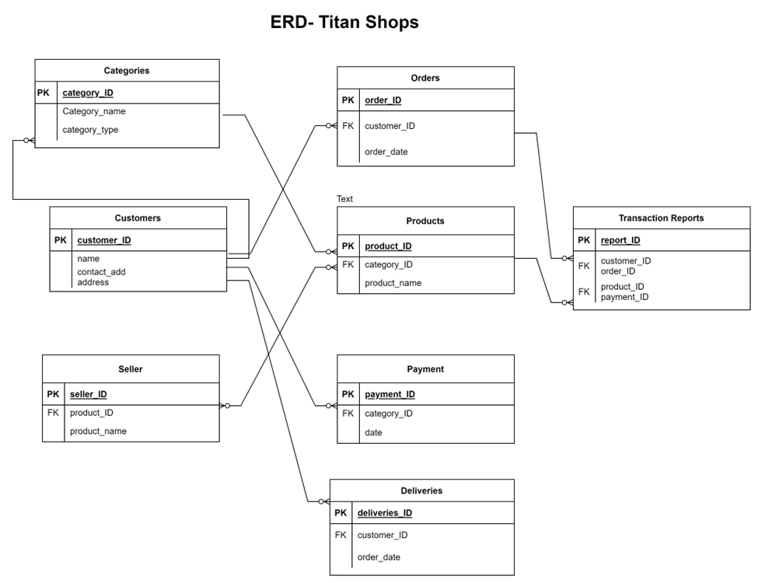
Logical Data Model

Slide 35

Data Dictionary

Slide 36

Categories
Categories
Data Dictionary
Name | Definition | Datatype | Required?
category_ID | ID of the Category | Number | Yes
category_name | Name of the Category | Text | Yes
category_type | Type of the Category | Text | No
Data Dictionary
Name | Definition | Datatype | Required?
category_ID | ID of the Category | Number | Yes
category_name | Name of the Category | Text | Yes
category_type | Type of the Category | Text | No

Slide 37
Customers
Data Dictionary
Name | Definition | Datatype | Required?
Customer_ID | PK- unique ID of a customer | Number | Yes
Name | Name of the customer | Text | Yes
contact_add | E-mail of the customer | Text | Yes
address | Address of the customer | Text | No

Slide 38
Seller
Data Dictionary
Name | Definition | Datatype | Required?
seller_ID | PK- unique ID of a seller | Number | Yes
product_ID | ID of a Product | Number | Yes
product_name | Name of a product | Text | Yes

Slide 39
Orders
Data Dictionary
Name | Definition | Datatype | Required?
order_ID | PK- unique ID of an order | Number | Yes
customer_ID | ID of the customer that placed an order | Number | Yes
order_date | Date on which the order has been placed | Date | Yes

Slide 40
Products
Data Dictionary
Name | Definition | Datatype | Required?
product_ID | PK- unique ID of a product | Number | Yes
category_ID | Category ID of a Product | Number | Yes
product_name | Name of a product | Text | Yes

Slide 41
Categories
Payments
Data Dictionary
Name | Definition | Datatype | Required?
payment_ID | PK- unique ID of payment | Number | Yes
category_ID | ID of a category | Number | Yes
date | Date of payment done | Date | No
Data Dictionary
Name | Definition | Datatype | Required?
category_ID | ID of the Category | Number | Yes
category_name | Name of the Category | Text | Yes
category_type | Type of the Category | Text | No

Slide 42
Deliveries
Data Dictionary
Name | Definition | Datatype | Required?
delivery_ID | PK- unique ID of delivery | Number | Yes
customer_ID | ID of a customer | Number | Yes
order_date | Date of order | Date | Yes

Slide 43
Transaction Reports
Data Dictionary
Name | Definition | Datatype | Required?
report_ID | PK- unique ID of a report | Number | Yes
customer_ID | Unique ID of a customer | Number | Yes
order_ID | Unique ID of an order | Number | Yes
product_ID | Unique ID of a Product | Number | Yes
payment_ID | Unique ID of Payment | Number | Yes

Slide 44
Report ID | RPT-1
Report Title | Ordered product History
Report Purpose | Customer wants to see a list of all products that he had previously ordered from the Titan Shops over a specified time period up to 6 months prior to the current date, so he can reorder a particular product he liked.
Priority | Medium
Report Users | Customers
Data Sources | Database of Previously placed orders
Frequency and Disposition | Report is generated on demand by Customers. Data in the report is static. Report is displayed on the user's web browser screen on a computer, tablet, or smartphone. It can be printed if the display device permits printing.
Visual Layout | Landscape mode
Header and Footer | Report header shall contain the report title, Patron’s name, and date range specified. If printed, the report footer shall show the page number.
Report Body | Fields shown and column headings: ■ Order ID ■ Order Date ■ Items Ordered ■ Total Price ■ Tax ■ Delivery Charge ■ Total Price (sum of product prices, tax, and delivery charge) Selection Criteria: date range specified by Customers, inclusive of end points Sort Criteria: reverse chronological order
End-of-Report Indicator | None
Security Access Restrictions | Customers may retrieve only his own order history.
Reports

Slide 45
Data Acquisition, Integrity, Retention, and Disposal
Data Integrity
Data Integrity has been established using Primary and Foreign Keys in each column, as well as the prohibition of null values in certain required fields.
Null is not allowed in some fields, such as Customer ID and Customer Name.
Data Retention
A customer's order history will be retained for a year.
Website visitor data will be retained as long as necessary to provide the service requested/initiated through the website.
Personal data of vendors will be kept for the duration of the contract or agreement.
Data associated with tax payments will be held for 3 years.
Data Disposal
The System used a method called "Sanitizing and Wiping" to get rid of data. Special software can overwrite any stored information, making it impossible to read or recover.

Slide 46

External
Interface
Requirements

Slide 47

User Interface
It is the main platform where the customer comes across the website that makes it easier for sports enthusiasts to find the top personalized sport goods which is easily accessible to everyone. It focuses on the fonts, icons, button labels, images, color schemes, commonly used controls, branding graphics, copyright and privacy notices, screen size, layout, resolution constraints, footer navigation links, and shortcut keys that will appear on every screen, from one product to other similar items and their availability. Data validation such as input value restrictions for employee portal as it works by the filter feature which functions based on the details provided by employees during data entry.

Slide 48

Software Interface
E-commerce analytics is like a report that shows the purchase activity and transaction details on the website. It allows you to analyze average order value, conversion rate, time to purchase and other data. E-commerce transactions are ideally suited for relational databases instead of document databases such as MYSQL and oracle databases. API is an easy and seamless process of sharing data between different applications. We referred to some of the famous APIs such as Amazon and Shopify API for the project. Non-functional requirements affect the interface, such as service levels for response times and frequencies, as well as security controls such as contacting the IT assistance to reopen the site in the employee's portal after 3 wrong attempts of their password.

Slide 49

Hardware Interfaces
The company must consider the size, purpose, and traffic on the site to determine the use of server hardware. Storage capacity and computing power required of the web server depends on the volume of the e-commerce websites and software that will run on the computer. It contains HTML, PHP, JavaScript, database, and media files that make up the entire website and are stored in a web server. Hardware for setting up a web server completely depends on our requirements such as 200 GB disk, 8 CPU cores, 16 GB RAM, and the traffic up to 1000 users.

Slide 50

Communication Interfaces
Email attachments and promotional offers of the website should be considered, which promotes to our target audience. Communication between the customers plays a vital role in the progress of the website, by taking the feedback and reviews from products bought by the customers and improvising the site by the suggestions communicated by the users.

Slide 51

ATTRIBUTES

Slide 52

USE-1 - As an e-commerce website our success depends on the impression we leave on the customers. The system has been designed in such a way that it's easy for the customers to understand the navigation in the app. The system follows an opt-in/opt-out process for guiding in the app, for the customers who already have knowledge in e-commerce they can opt-out
USE-2 - The system also focuses on memorability. The app remembers actions and double checks if it thinks any errors are occurring like duplicate payment or duplicate orders.
USE-3 - The system also focuses on interactions with the customers. The system gets to know their feedback on what went right and what went wrong, and it's made sure that the customer is happy with the service and the amount of value they get back for their feedback.

Slide 53

Performance
When it comes to performance, it is a collection of all operations working perfectly.
The application needs to give its peak performance most of the time, as it shouldn’t run into bugs or errors often. The software development team has to keep an eye on the application.
The app should be available most of the time, so during downtime or maintenance we try to keep it as low as possible so that customers don't have any dissatisfaction. The maintenance team should also focus on the application so that it won't run into any errors or maintenance issues. If all these teams work together then we can keep the application running and customers satisfied.
Proper connection with third-parties like payment transactions with banks should be done properly so that customers won't run into any issues. Organization also must maintain proper contact with the delivery service so that customers get their order on time.

Slide 54


Slide 55

SEC-1- The Customer’s privacy plays a very important role in the application. Customer’s data and actions in the application will not be monitored. Schemes like loyalty cards are not used where the system tracks customers' usage and gives coupons on frequently purchased items.
SEC-2- Customers also have an option where they can select to opt-in or opt-out of the data privacy policies. A customer or user can opt-in and the customer will get recommendations based on the purchases made.
SEC-3- The system should also protect our application from getting hacked and sensitive data like card details from getting stolen. The application shall also offer a pay at delivery option where customers can pay when they get delivered if they don't feel like giving their card details.
SEC-4- So in this application the user’s actions are recorded but they are not monitored and are not used against them just like any other applications do. The application aims to give preference to the customers interests and respect their privacy.

Slide 56


Slide 57

SAF-1- Not just the customer's safety, but the safety of the application is also important so that the application can be kept running most of the time. The system shall protect the application from hackers and fraudsters who buy limited edition stock in bulk and use them for their own profit.
SAF-2- To protect potential dangers, the system shall block bulk buyers and keep a check on the number of customers returning the products, since it would be an extra cost for the organization to ship and then accept the return. The organization must be clear and specific about the return policies.
SAF-3- The potential dangers can also include other competitors. Our business should keep an eye on the products and prices offered by others so that our application doesn’t lose our customers. The application should be made safe from hackers to prevent changes in prices or steal sensitive data of customers.
SAF-4- The application must also mention the opt-in/opt-out for privacy and all other data related things in the privacy policies. This is so that the company will be ready to face any legal issues and keep the policy and work clean.

Slide 58
Additional Attributes
Availability - The application should be available 99% of the time to ensure customer satisfaction and have less downtime.
Efficiency - The application should be efficient and should be productive.
Modifiability - The system should also be ready for any changes made to it in the forms of updates. It should be made in such a way that the customer is able to understand the changes easily.
Reliability - The application should be running and give confidence to the customers that they can rely on the application for buying or being able to customize their own products.
Punctuality - The customers expect the product to be delivered by the date specified, so keeping the promise also plays an important role in the customer satisfaction and application rating.

Slide 59

Internationalization and Localization Requirements

Slide 60
The initial plan for the project will be to operate only within the United States, so localization will be based upon the different regions and states. One important localization aspect would be to sell products that different regions or states would be interested in purchasing.
Another aspect will be to accommodate the different types of addresses and locations for delivery, such as residential homes, apartments, condos, P.O. boxes, and businesses. The field for delivery location must allow for these and any additional details as a result, such as suite or unit number.
Multiple languages will also be another part of appealing to many different users in the U.S., since the country is home to many different cultures and immigrants from other countries. American-English and Spanish are two very common languages in the U.S. that are to be included, with plans to expand to more languages in subsequent releases.
Time zones are another aspect that will influence the website and its operation. The website will need to determine the user’s approximate location based on their IP address and adjust certain time-based functions. For example, time-based events, such as sales and delivery times, must reflect the user’s local time zone when displayed.
Under the hypothetical expansion to countries outside the U.S., there would be a large amount of localization changes to consider. One main change would be to incorporate sporting gear and teams that are popular in other countries and not in the U.S.

Slide 61

Legal, Regulatory, and Financial Compliance Requirements

Slide 62

THE SYSTEM MUST COMPLY WITH APPLICABLE LAWS AND REGULATIONS, SUCH AS
Adhere to laws and regulations applicable to the business.
Comply with anti-corruption and anti-money laundering laws and regulations.
Ensure data protection and privacy laws are followed.
Comply with labor and employment laws.
Comply with intellectual property laws.
Comply with consumer protection laws.
Comply with industry and sector specific regulations.
Follow safety and environmental regulations.
Comply with financial services regulations.
Comply with food and drug regulations.

Slide 63
2. The System must adhere to industry standards, such as the Payment Card Industry Data Security Standard (PCI DSS) and the International Organization for Standardization (ISO).
3. The System must ensure financial compliance by having adequate internal controls and procedures in place to prevent fraud and money laundering such as
Adhere to accounting principles and standards.
Comply with corporate governance requirements.
Follow tax laws and regulations.
Comply with securities regulations.
Comply with banking regulations.
Follow export and import regulations.

Slide 64

Machinery Installation, Configuration, Startup, And Shutdown Requirements
1. The System must ensure that machinery is installed and configured correctly in order to ensure proper functioning.
2. The System needs skilled personnel to operate and monitor this machinery and needs a lot of electricity to run the machinery.
3. To avoid unwanted access, the System must make sure that machines are safely connected to other systems.

Slide 65
Logging, Monitoring, and Audit Trail Requirements
1. To identify and stop possible security problems, the System must make sure that all the activity is recorded, tracked, and audited.
2. The System must ensure that all system access is logged, monitored, and audited in order to detect and prevent unauthorized access.

Slide 66
Business Rules
ID | Rule Definition | Type of Rule | Static or Dynamic | Source
BR-1 | Delivery time is 1-7 days. | Fact | Dynamic | Shipping policy
BR-2 | Deliveries must be completed between 7:00 A.M. to 7:00 P.M. local time. | Constraint | Dynamic | Shipping policy
BR-3 | All items in single order must be delivered at the same location. | Constraint | Static | Shipping policy
BR-4 | All items in a single order must be paid using the same payment method. | Constraint | Static | Payment policy
BR-12 | Order price is calculated as the sum of each product price times the quantity of that product, plus applicable sales tax, plus shipping charge if delivery is outside the delivery zone. | Computation | Dynamic | Business policy; state government tax code
BR-15 | Deals and offers are for registered customers only. | Constraint | Static | Account policy
BR-24 | The employees or staff working with the system are designated as admin who can add, update, remove items. | Constraint | Static | Administrative policy
BR-26 | Only inventory staff or employees are designated to track the goods availability to generate daily goods usage reports. | Constraint | Static | Shipping policy
BR-33 | Network transmissions involving personal information (e.g. payment details, name, home address, email) require 256-bit encryption. | Constraint | Static | Corporate security policy
BR-41 | Only delivery staff or employees are designated to print the delivery instructions and confirmation. | Constraint | Static | Shipping policy
BR-86 | Payment should be made via third-party payment modes (i.e. using bank API’s, credit cards, debit cards, net banking, etc.) | Fact | Dynamic | Payment policy

Slide 67


